Slide 1
WORKSHOP
Not Every Agent Needs a Frontier Model
CYPHER 2026 | Nitin Agarwal

Slide 2
02
What we will cover
Stage classification
01
SLM-appropriate stages (classification, extraction, routing, reranking) vs. LLM stages (synthesis, ambiguity, judgment).
Hybrid pipeline design
02
Explicit per-stage model selection — not “call the biggest model for everything.”
Passive RAG → agentic
03
Query rewriting, multi-agent routing, optional self-reflection — and whether the extra reasoning is worth it.
Real metrics
04
Quality, latency (P50/P95), cost per query, SLM-vs-LLM call mix — not just a plausible-looking answer.
Not Every Agent Needs a Frontier Model
Workshop

Slide 3
Small Language Models
The count heuristic
The deployability definition
Anything under roughly 10 billion parameters is treated as small, as of 2025.
Frontier LLMs sit at hundreds of billions — GPT models are reported above a trillion.
Easy to say, but it ages badly. Today's "large" is next year's phone model.
An SLM is a model that fits on a common consumer device and answers fast enough to serve one user's agentic requests.
An LLM is simply everything that isn't.
Anchored on what you can actually ship
3
Notes:
NVIDIA's working definitions WD1/WD2. The authors deliberately avoid a parameter number so the definition stays timeless.

Slide 4
03
LLM: The default is expensive
Most multi-agent systems route every call to the largest model — maximizing quality on hard tasks and wasting budget on easy ones.
Latency
Cost
Capacity
Frontier models add seconds per call. Classification and extraction rarely need that depth.
Token price scales with model size. Easy stages often dominate total call volume.
GPU and rate limits are finite. Spending them on rewrite steps starves judgment stages.
Thesis: match model size to stage difficulty — then measure it.
Not Every Agent Needs a Frontier Model
Workshop

Slide 5
04
Which stages need a frontier model?
SLM-APPROPRIATE
LLM-REQUIRED
Small models are enough
Still need stronger models
Classification
Open-ended synthesis
Intent, validity, topic tags
Plans, long reports
Extraction
Ambiguity resolution
Keywords, entities, fields
Conflicting evidence
Routing
Multi-criteria judgment
Phase / agent handoff
AGI scoring (10 axes)
Reranking
Self-reflection
Lightweight relevance
Critique / gap analysis
Constrained rewrite
Nuanced ranking
Short keyword queries
Subtle quality differences
Not Every Agent Needs a Frontier Model
Workshop

Slide 6
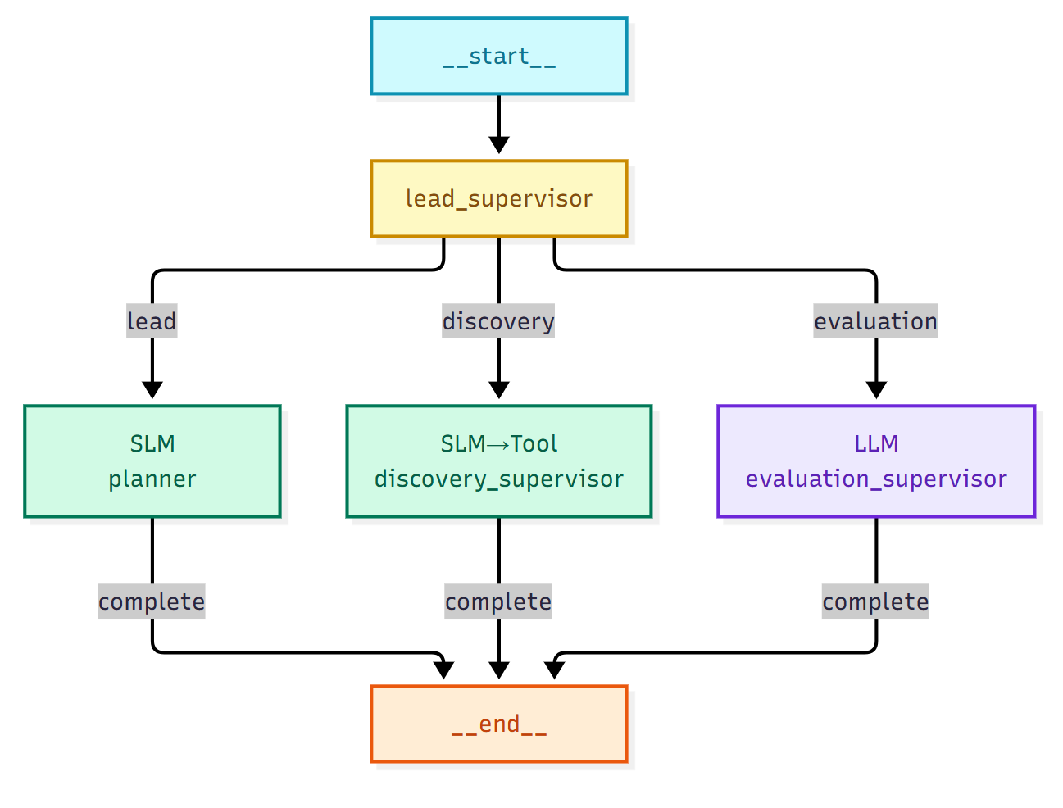
06
Agent orchestration graph
Lead supervisor routes work; specialists report completion back
What this graph shows
A lead supervisor dispatches to specialist agents (planner, discovery, evaluation). Each specialist can use a different model size. Completion flows back — not every node needs an 8B brain.
Hybrid policy on this graph
planner + discovery → SLM (0.5B)
evaluation + report → LLM (8B)
Routing stays explicit via choose_model(stage, mode).
Not Every Agent Needs a Frontier Model
Case study

Slide 7
08
Design principles
1
Classify stages first
Label each step as classification / extraction / routing vs. judgment / synthesis before picking a model.
2
Default to SLM, escalate to LLM
Use the small model unless the stage requires open-ended reasoning or multi-criteria judgment.
3
Make routing explicit
A choose_model(stage, mode) policy beats “always call the biggest model.”
4
Measure the mix
Track quality, P50/P95 latency, cost, and SLM vs LLM call share — not just whether the answer looks good.
5
Agentic only when it pays
Query rewrite and multi-agent routing help when discovery is fragile; pure judgment stages still need the LLM.
Not Every Agent Needs a Frontier Model
Workshop

Slide 8
07
Measured results (FIXED run)
SLM wall-clock
LLM wall-clock
Hybrid wall-clock
LLM avg AGI
52s
266s
121s
71.1
6 calls · 0 LLM
6 calls · 0 SLM
2 SLM · 4 LLM
2 High papers
Mode
Papers
Avg AGI
High
Wall-clock
SLM
LLM
Est. cost
SLM
3
61.1
1
52s
6
0
$0.00016
LLM
3
71.1
2
266s
0
6
$0.00132
Hybrid
3
55.1
0
121s
2
4
$0.00087
Key read
SLM is ~5× faster than pure LLM. Hybrid cuts latency roughly in half vs LLM while keeping judgment on the large model (4 of 6 calls). Quality edge still sits with the LLM — as expected for multi-criteria scoring — but cost and latency favor Hybrid for production volume.
Not Every Agent Needs a Frontier Model
FIXED notebook

Slide 9

Not every agent needs
a frontier model.
Match model size to stage difficulty.
Measure quality, latency, cost, and call mix.

